Slide 1
Electrochemically Mediated Photoredox Catalysis
Matthew Albritton
Group Meeting
January 23, 2024
^{e-}

Slide 2
Outline
Photoredox Catalysis vs. Synthetic Electrochemistry
Relative Advantages/Disadvantages
Prototypical Modern Examples
Electrochemically Mediated Photoredox Catalysis (e-PRC)
Photoexcited Electrochemically Generated Radical Ion Photocatalysts
Electrochemically Regenerated Photocatalysts

Slide 3
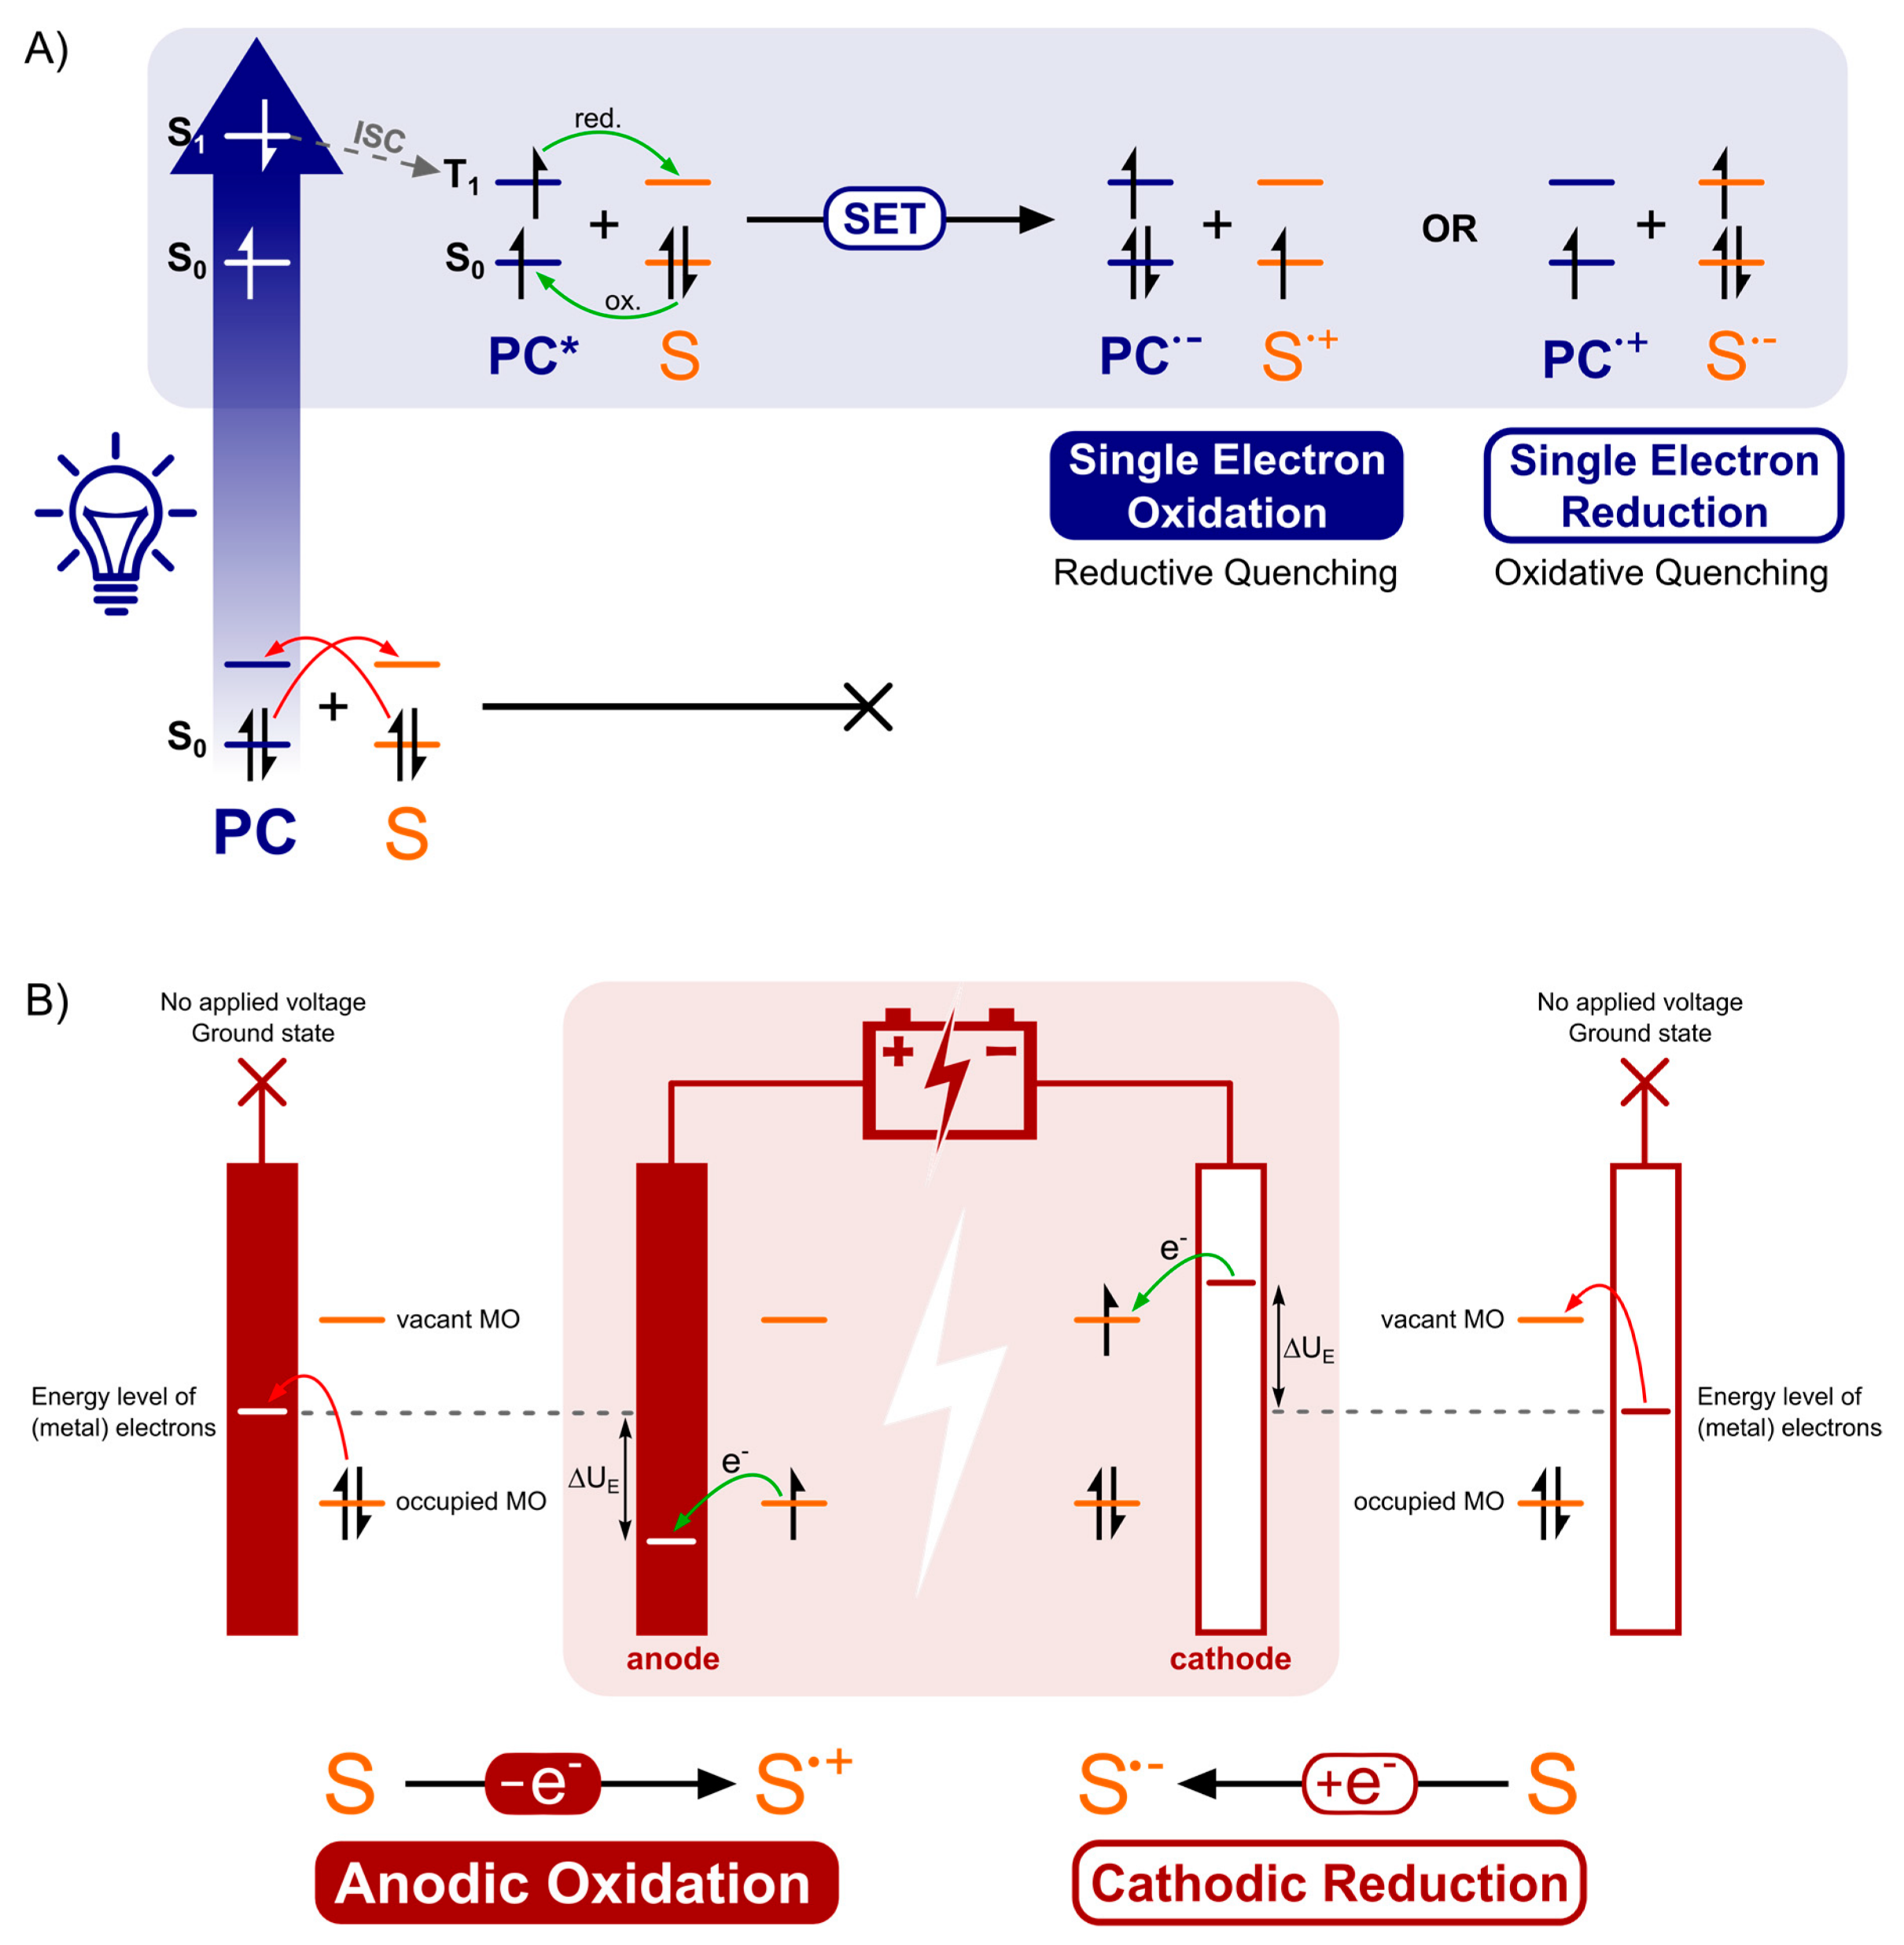
Photoredox Catalysis & Synthetic Electrochemistry:
Redox Initiation
Synthetic Electrochemistry

Slide 4
Photoredox Catalysis & Synthetic Electrochemistry:
Redox Initiation
Photoredox Catalysis

Slide 5
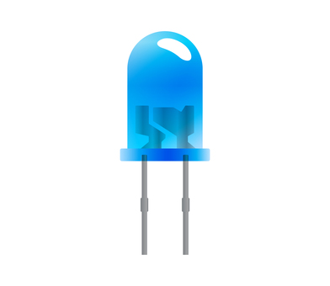
Photoredox Catalysis: Advantages
Redox-neutral reactions are very efficient as PC can act as both reductant and oxidant
Homogenous reaction conditions
Redox potential of excited photocatalyst is independent of energy input

Slide 6
Photoredox Catalysis: Disadvantages
Net oxidative or reductive reactions usually* require stoichiometric redox agents
Some PCs are very expensive
Tuning redox window can require synthesizing new catalysts
Redox window limited by energy of visible light photons, up to 2.8 V
Other reaction components may experience photodegradation

Slide 7
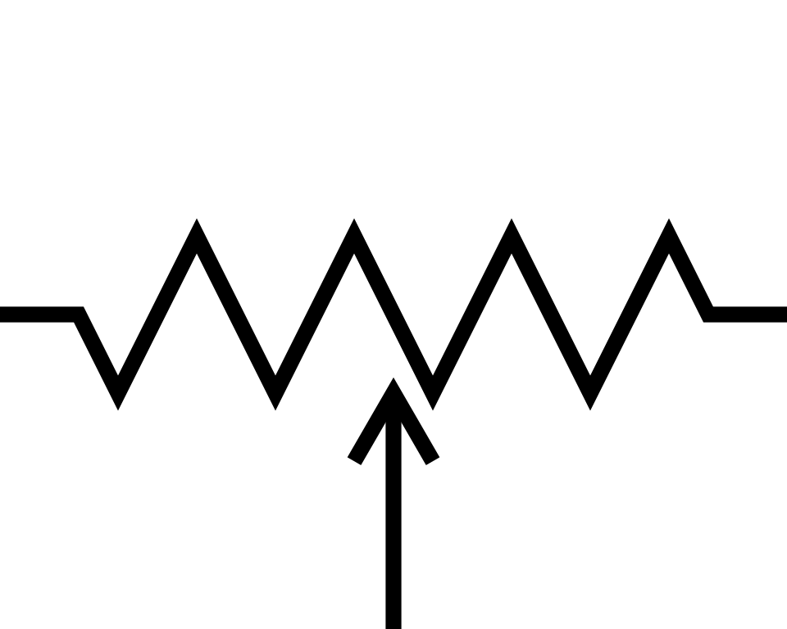
Synthetic Electrochemistry: Advantages
^{e-}
^{e-}
Divided cell allows for isolation of working electrode redox activity
M =
Zn, Mg, Cu, etc.
Pt
Stoichiometric soluble redox agents not required. Pt cathode can reduce H⁺, sacrificial anodes can supply electrons
Divided Cell
Undivided Cell
High, localized concentration of radicals can enable radical coupling reactions and 2-electron redox reactions
Potentiometers allow for easy variation of redox potential

Slide 8
Synthetic Electrochemistry: Disadvantages
^{e-}
Spatial separation of anodic and cathodic reactions makes redox-neutral reactions more difficult
>1 mm
Organic solvents have a high resistivity, overpotentials are typically required to obtain acceptable reaction rate especially as reactant concentration decreases. This leads to undesired side reactions.
These same reactions can be undesired side reactions

Slide 9
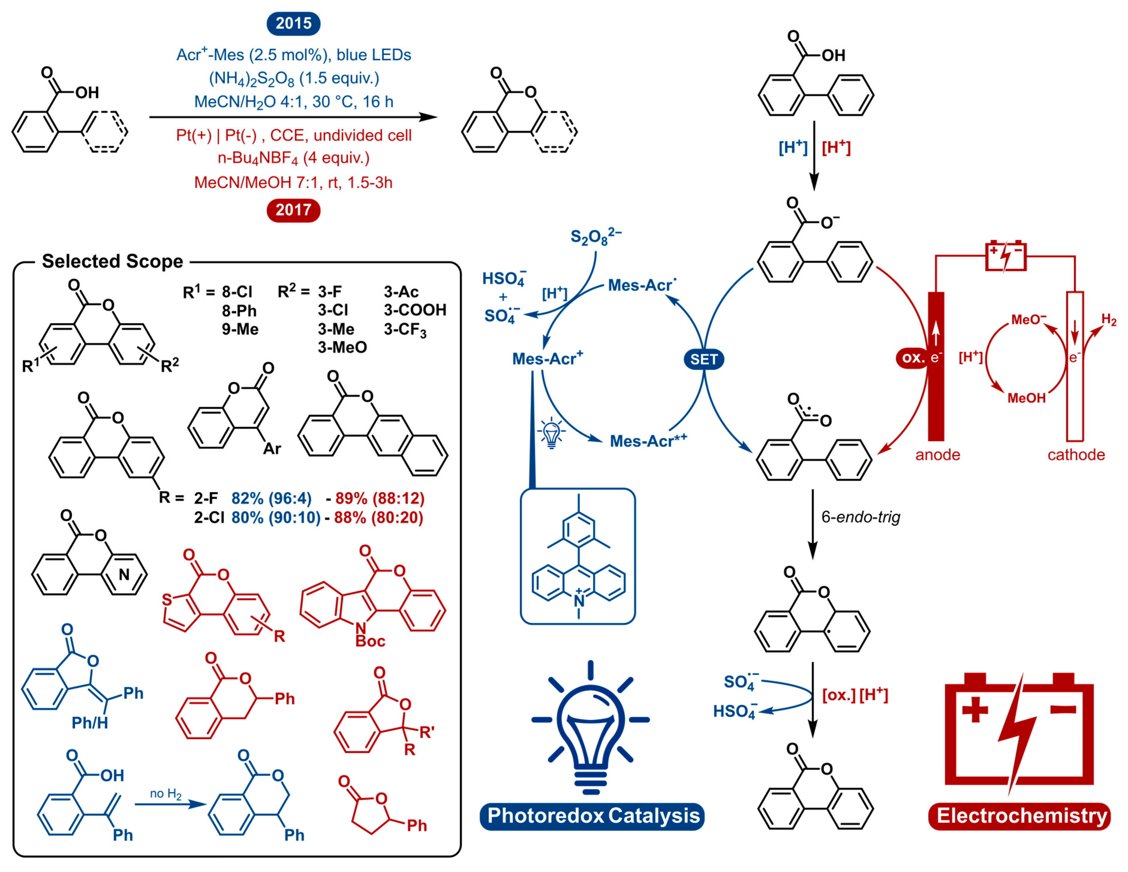
Side by Side Comparison

Slide 10
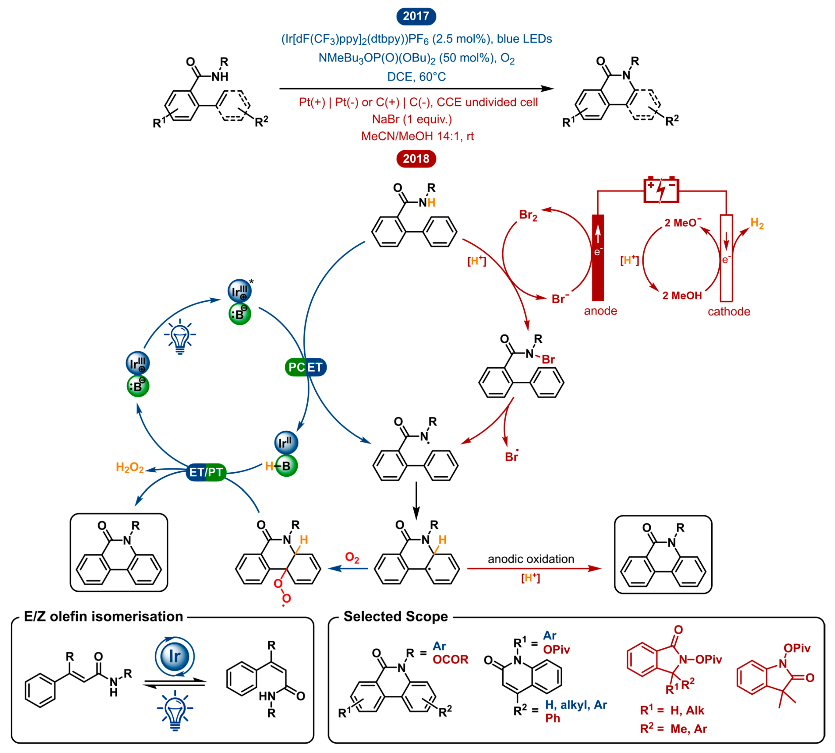
Side by Side Comparison
Verschueren, R.H.; De Borggraeve, W.M. Molecules 2019, 24, 2122
Zhang, S.; Li, L.; Xue, M.; Zhang, R.; Xu, K.; Zeng, C. Org. Lett. 2018, 20, 3443–3446.
Moon, Y.; Jang, E.; Choi, S.; Hong, S. Org. Lett. 2018, 20, 240–243.

Slide 11
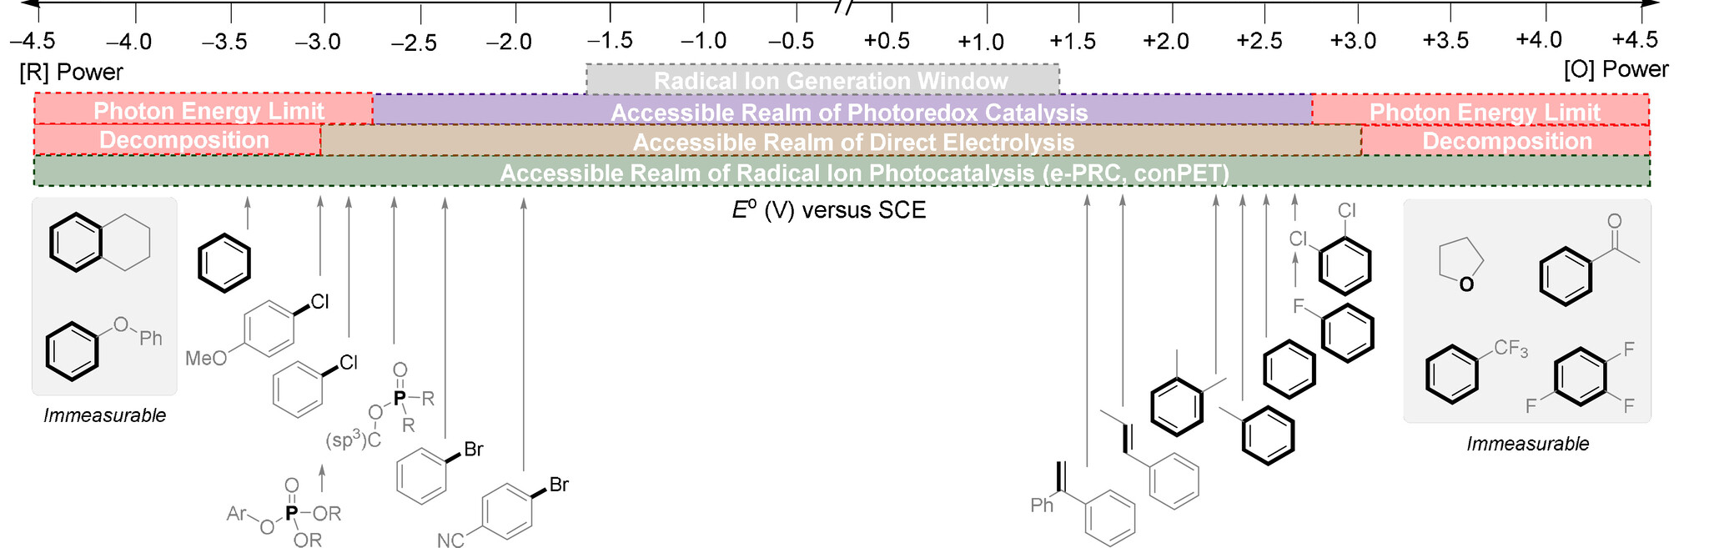
Limited Redox Window
Many desirable substrates possess reduction potentials or C-H BDEs too high for photoredox catalysis or electrochemistry to enable functionalization.

Slide 12
Electrochemically Mediated Photoredox Catalysis
Electrochemically Regenerated Photocatalysts
Photoexcited Electrochemically Generated Radical Ion Photocatalysts

Slide 13
Electrochemically Mediated Photoredox Catalysis
Electrochemically Regenerated Photocatalysts

Slide 14
Electrochemically Mediated Photoredox Catalysis
Electrochemically Regenerated Photocatalysts
66-90% yield
Oxidant-sensitive

Slide 15
Electrochemically Mediated Photoredox Catalysis
Electrochemically Regenerated Photocatalysis
Photoexcited Electrochemically Generated Radical Ion Photocatalysis
Standard
Photocatalysis

Slide 16
Electrochemically Mediated Photoredox Catalysis
Photoexcited Electrochemically Generated Radical Ion Photocatalysis

Slide 17
Electrochemically Mediated Photoredox Catalysis
Photoredox Catalyzed Method:
Restricted to electron-rich arenes due to limited redox window

Slide 18
e-PRC Oxidative Functionalizations

Slide 19
e-PRC Oxidative Functionalizations

Slide 20
e-PRC Reductive Functionalizations

Slide 21
e-PRC Reductive Functionalizations
Reductive Aryl Halide Substitution Mechanism

Slide 22
Summary
Photoelectrochemistry can enable reactions possessing the best qualities of both photoredox catalysis and electrochemistry while also enabling new reactivity
Replace stoichiometric redox agents in photoredox chemistry
Enable transient super-oxidants and super-reductants
Future prediction: Electrometallophotochemistry?

Slide 23
Questions?

